Slide 1
Final Project
Delgertamir Tserevkhuu , Adrian Martinez,
Braeden Vandenbelt

Slide 2
Topic
Of recently retired Major League Baseball players (batters only), we wanted to predict whether or not they would make the Major League Baseball Hall of Fame

Slide 3
Description of Data Source
The data was obtained from https://www.seanlahman.com/baseball-archive/statistics.
This specific data source contains player data dating all the way from 1871 to 2021. The data contains whether a player made the Hall of Fame or not and ll of their batting numbers.

Slide 4
Questions we hope to answer
Our project will be able to answer whether or not a recently retired Major League Baseball player will be inducted into the Hall of Fame
Because we are running the project as a classifier, it will broken up into two groups. “Yes” or “No”.

Slide 5
Data Exploration
The data exploration consisted of reviewing the data to see what it contains, what is missing, as well as what needs to be cleaned.
We found that our data set had a lot of “null” values that either needed to be filled or removed from the set entirely.
We also found that we needed to group or data by the “playerID” column and aggregate it by the hitting numerical values.
In the final dataframe we dropped any unnecessary columns.

Slide 6
Description of Analysis Phase
For the analysis portion of our project, we used supervised classification machine learning models to predict whether or not a player will make the Major League Baseball Hall of Fame
To do this, we tested the following models and assessed which had the overall highest accuracy:
Random Over Sampler
Random Under Sampler
SMOTE
SMOTEENN
We used these models because our data is imbalance.

Slide 7
Tools Used to Create Dashboard
We aggregated our data from our Pandas database into Tableau where we created an interactive environment that displays filters and visualizations for users to “play with”
Our dashboard show players inducted into the Hall of Fame by:
Award
Batting hand
Throwing hand
Number of homeruns
Number of HOF’ers vs Non HOF’ers
MLB debut
All-star games

Slide 8
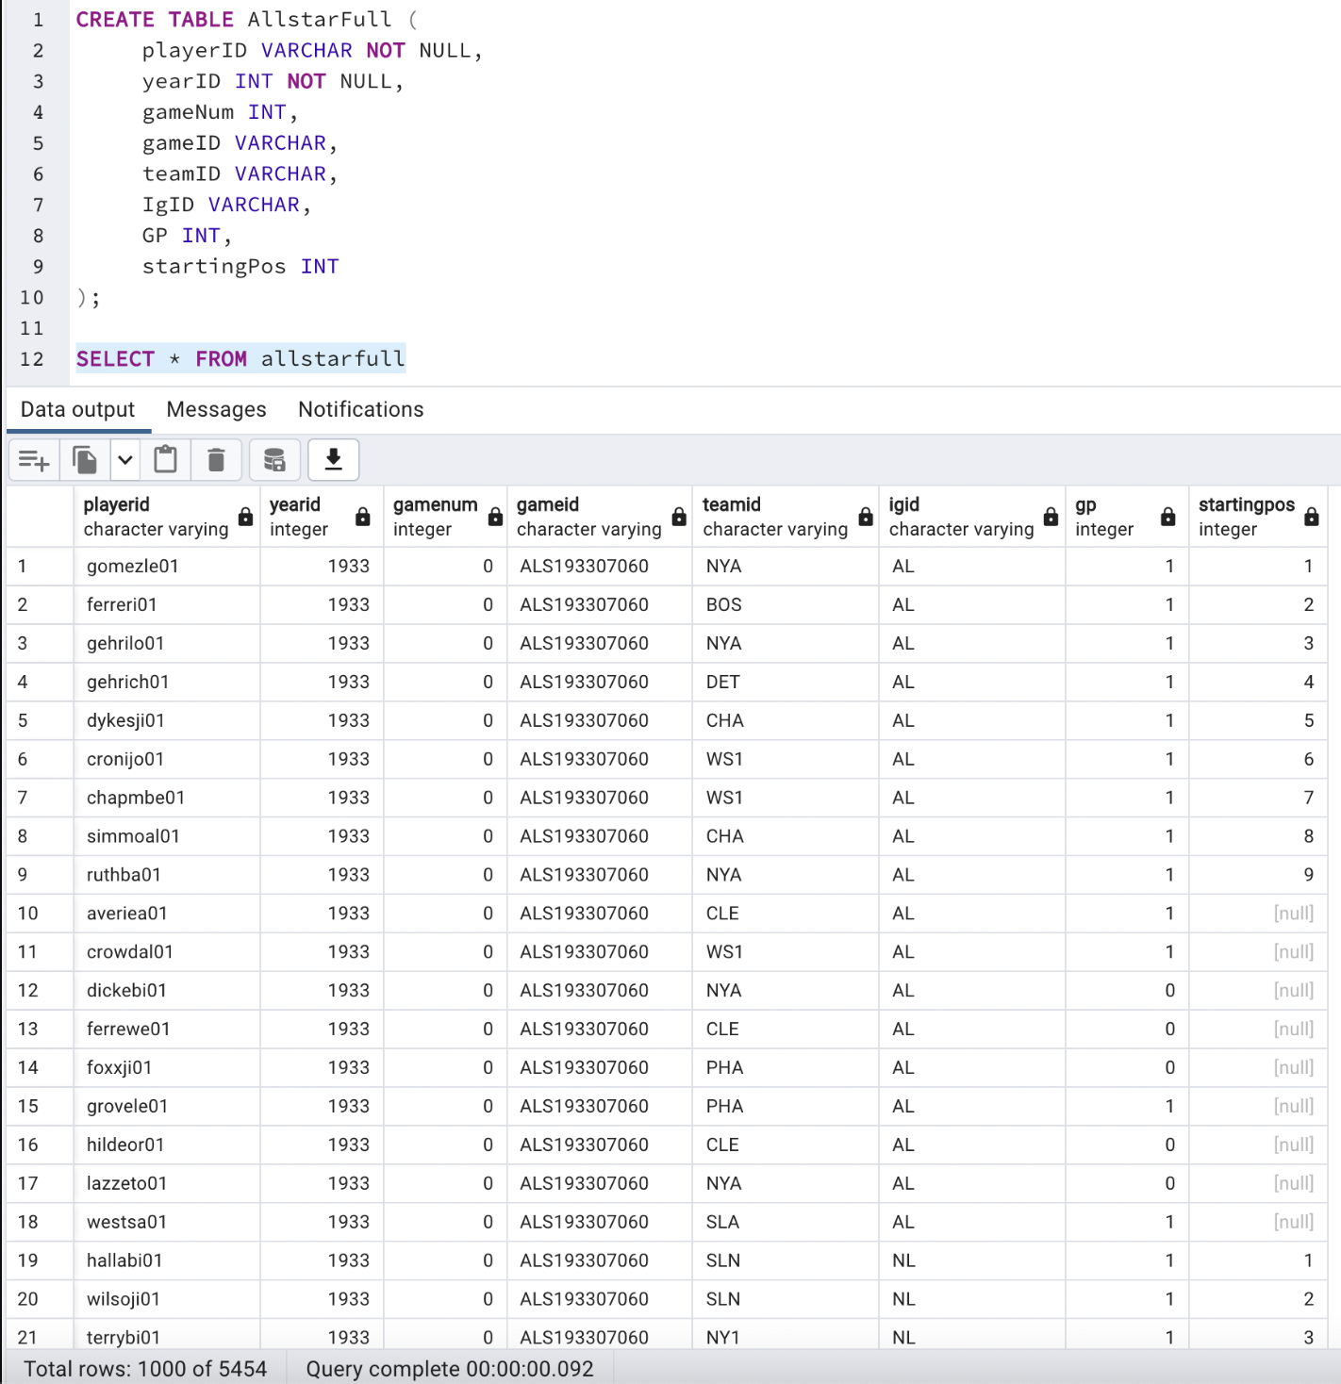
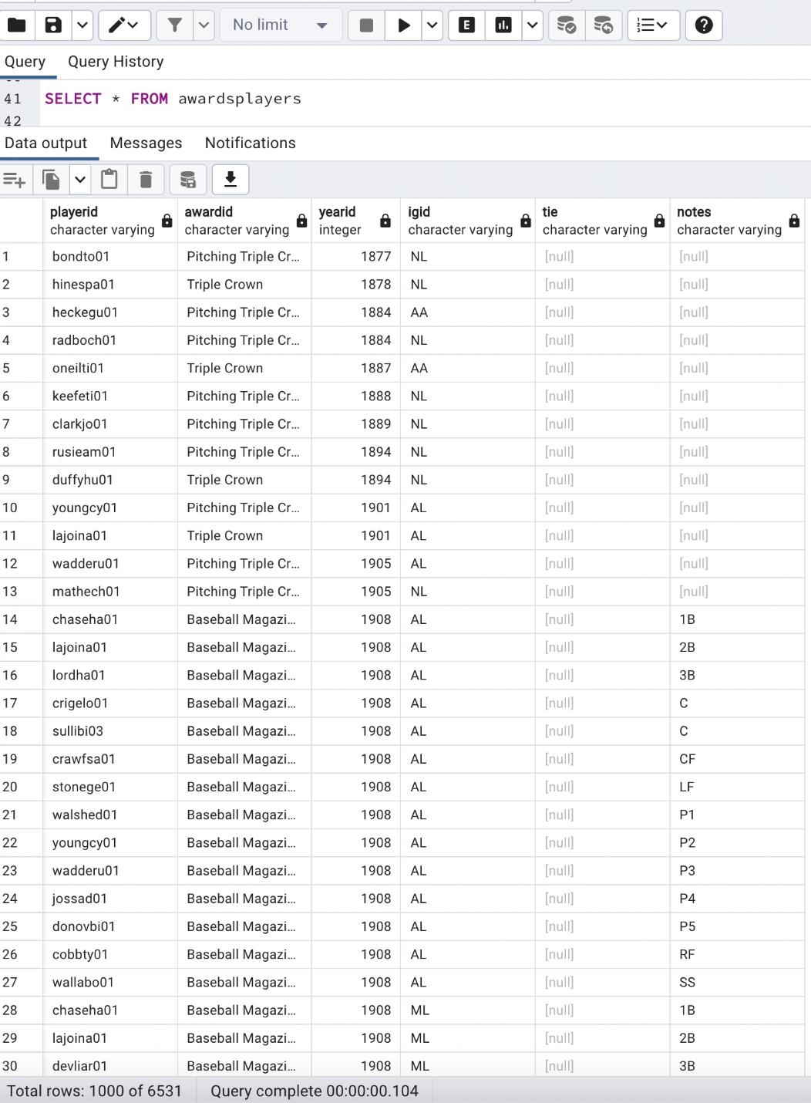
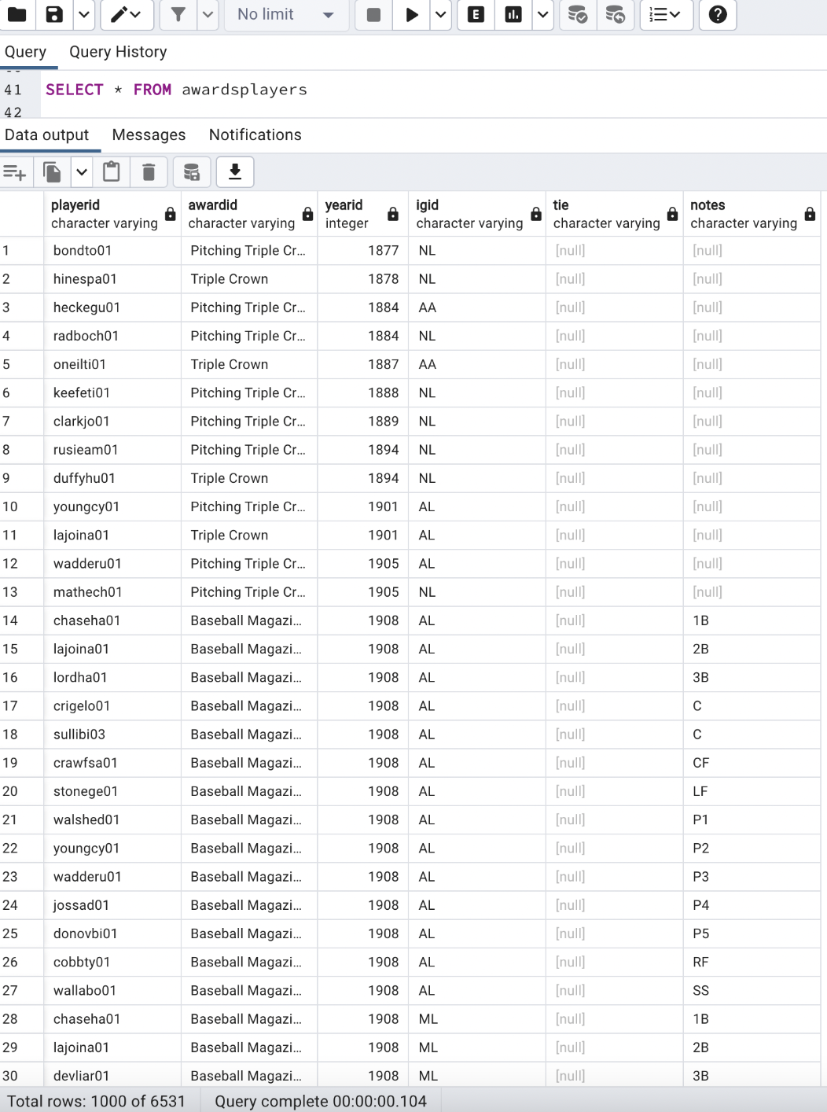
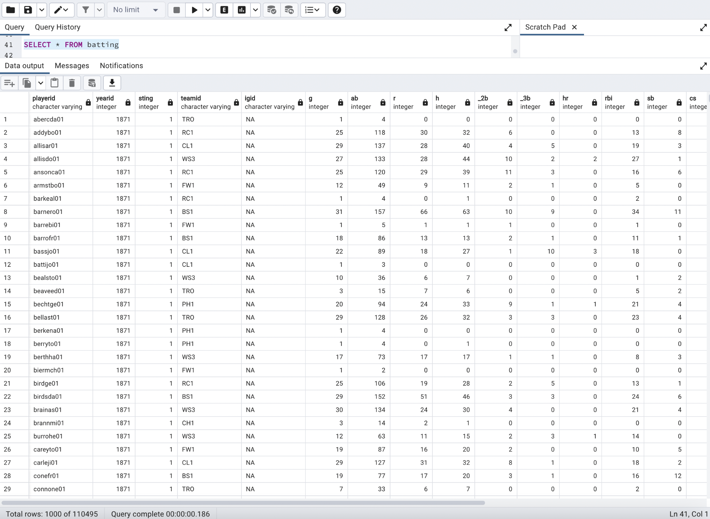
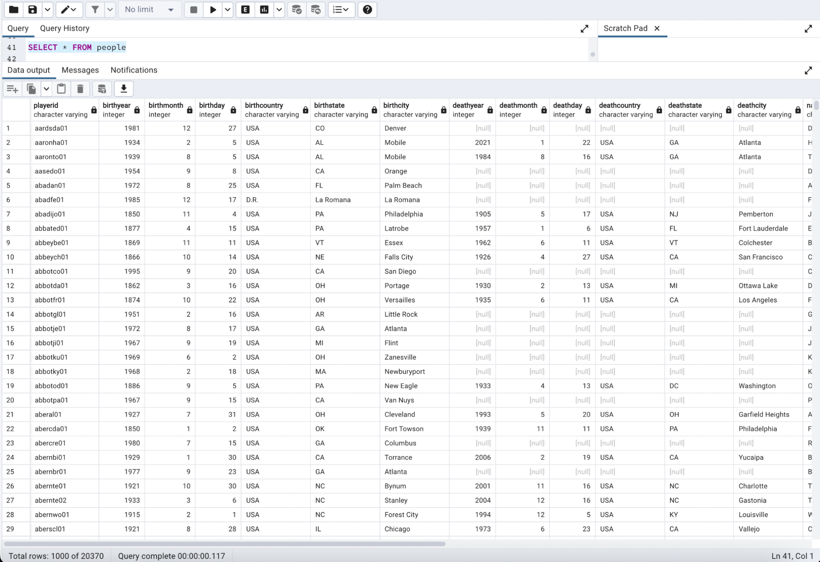
pgAdmin Tables per Data Source

Slide 9
Link to Python Data Analysis and Modeling
https://colab.research.google.com/github/adrianm240/baseball_statcast/blob/main/mlb_hof_ML_Class_Imbalance.ipynb

Slide 10
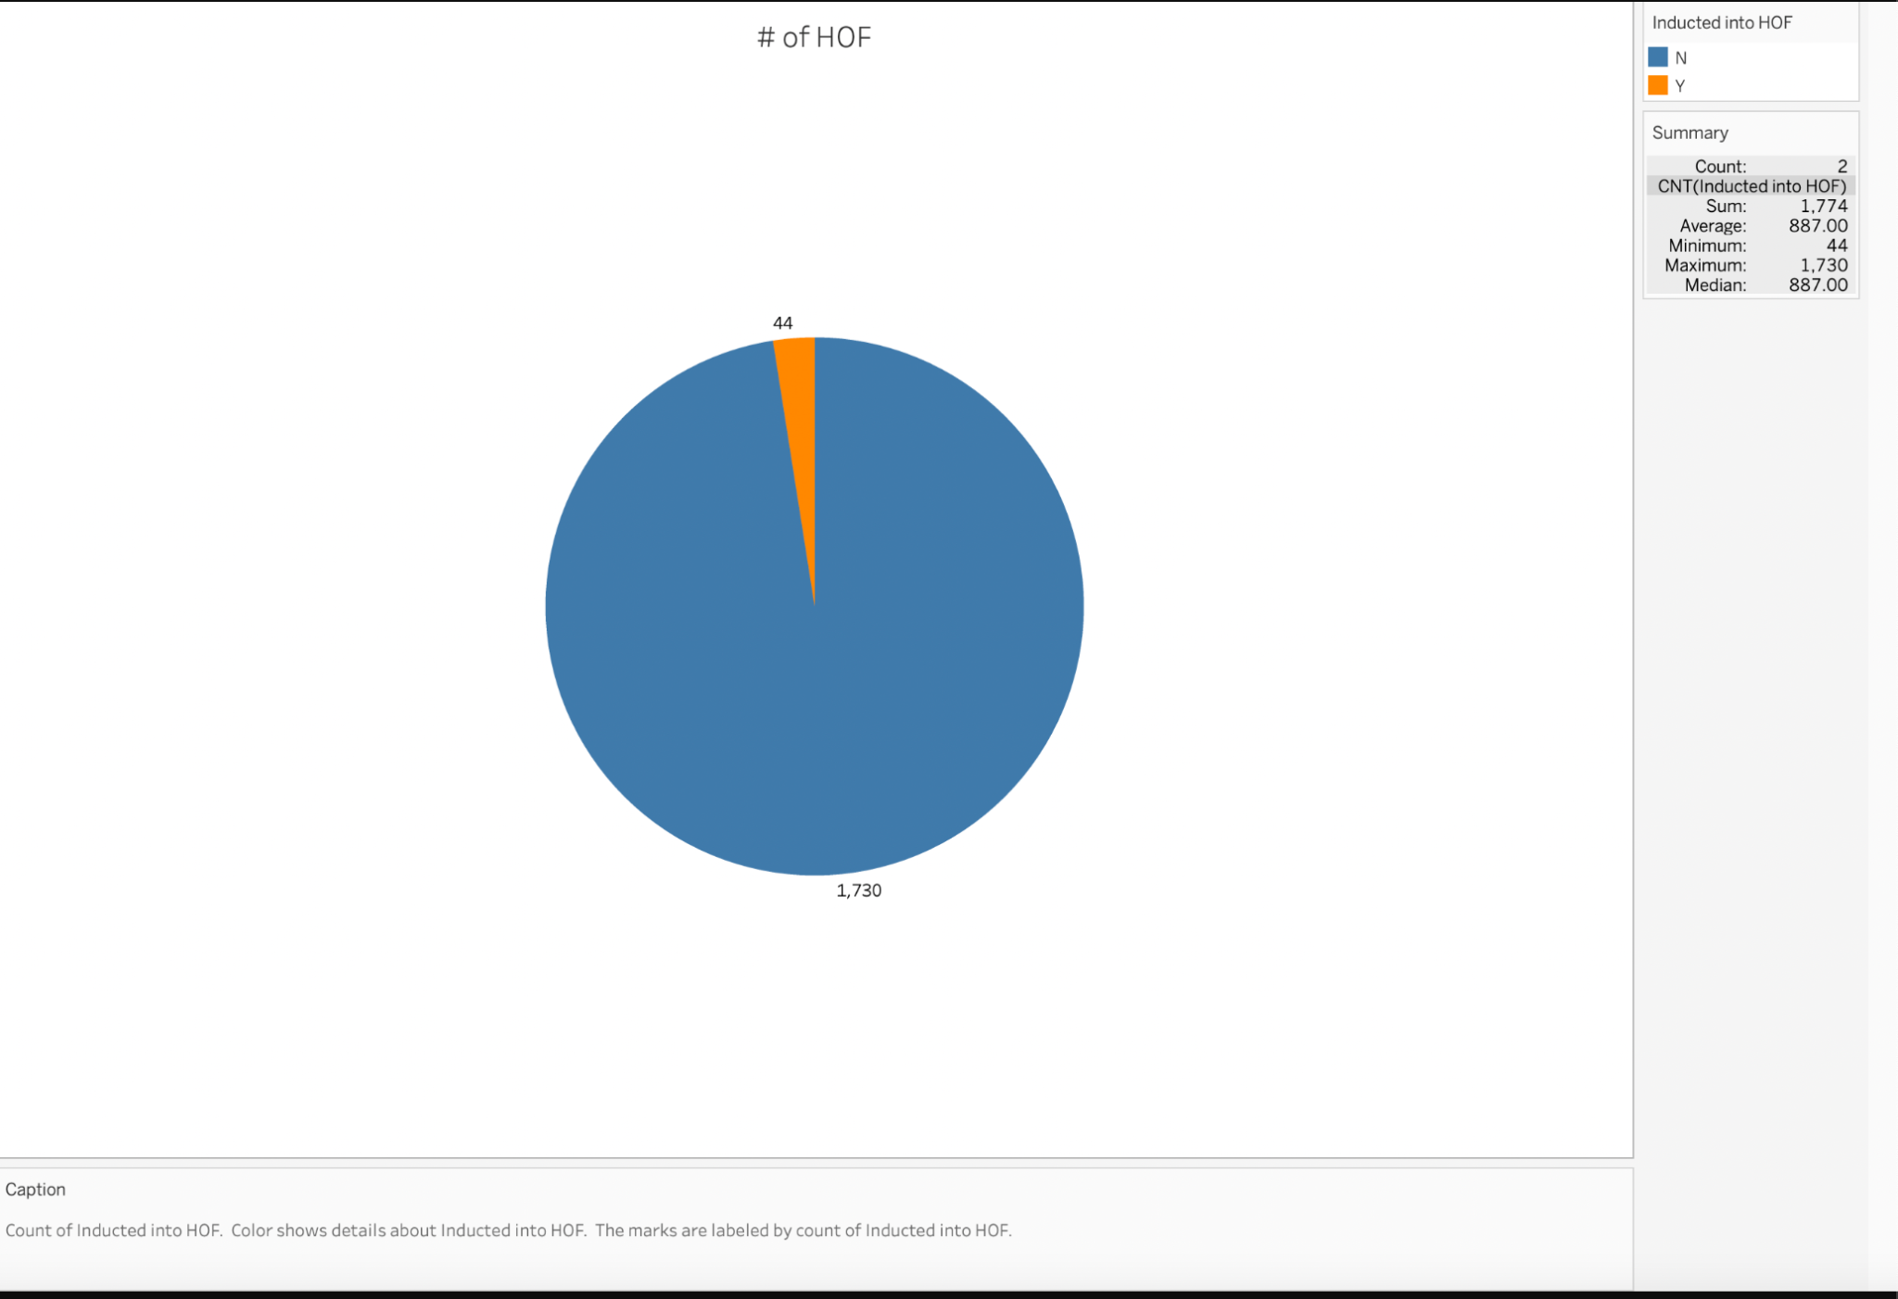

Slide 11
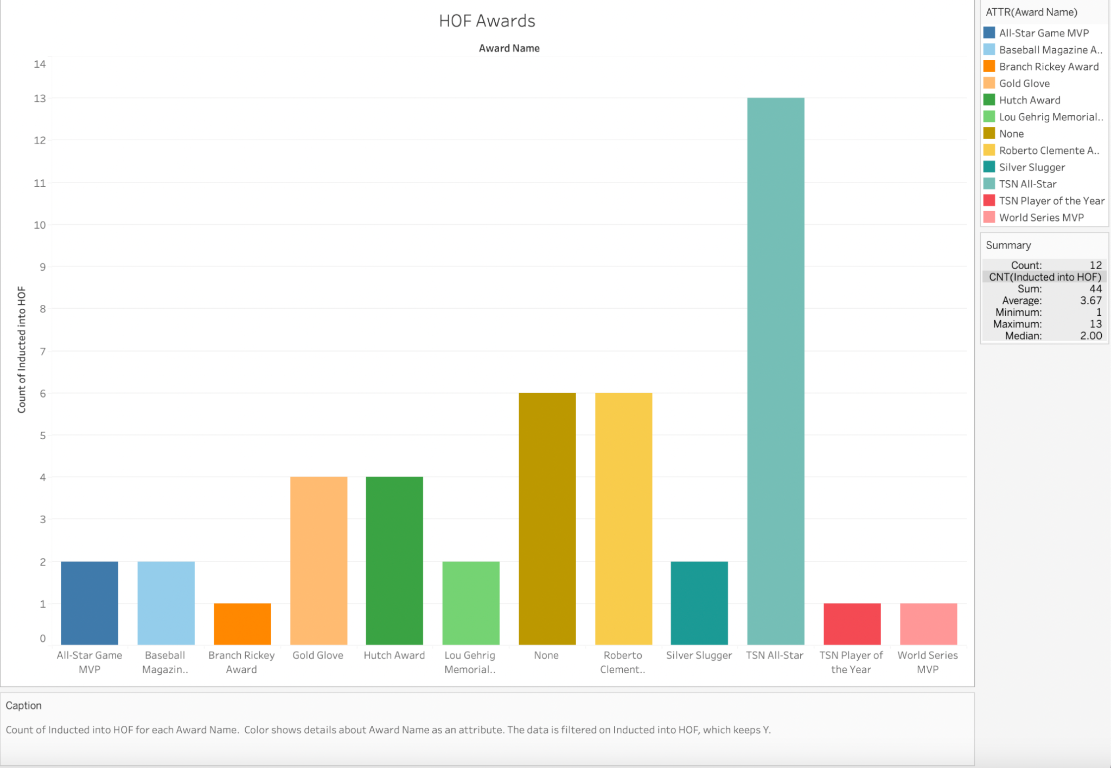

Slide 12
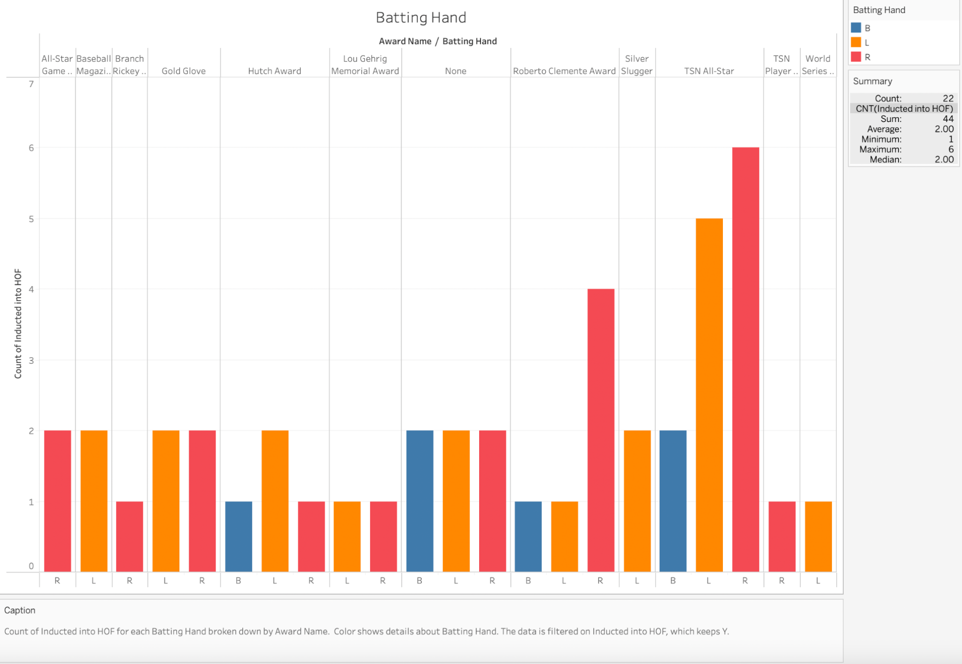

Slide 13
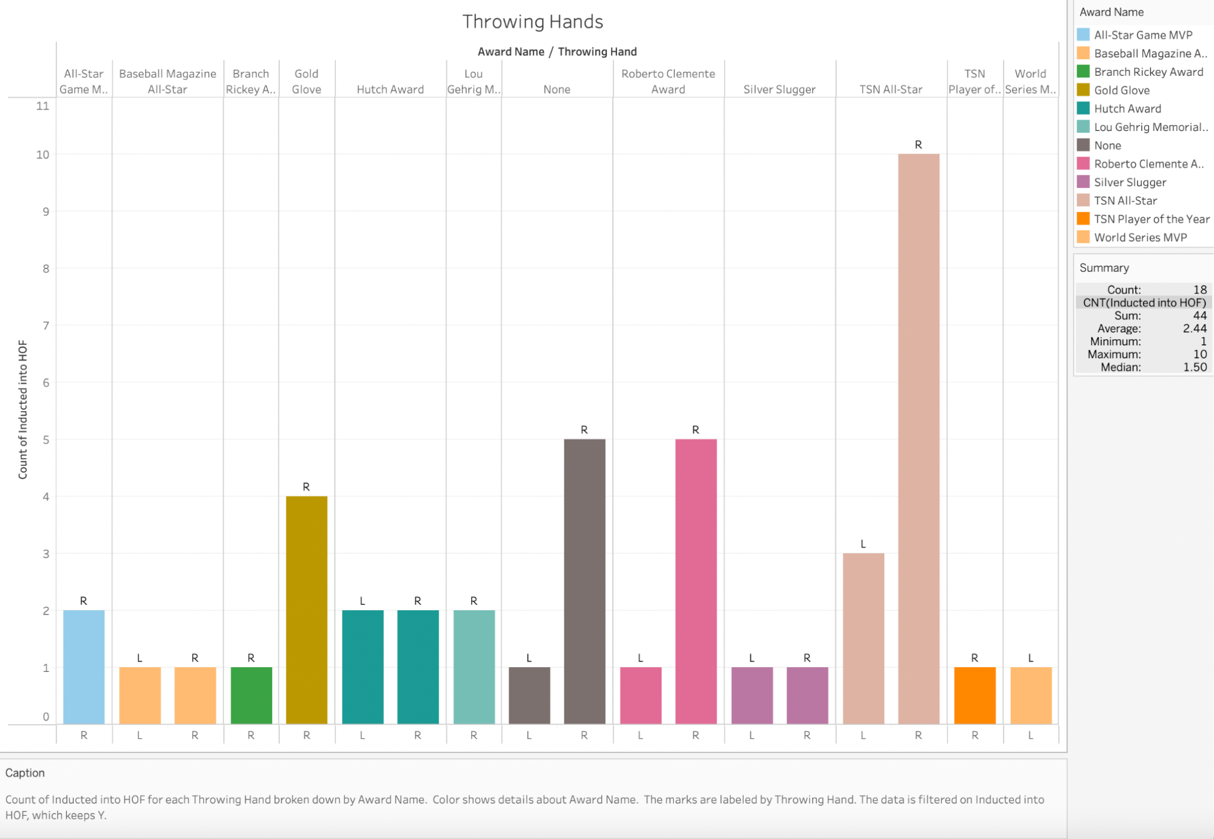

Slide 14
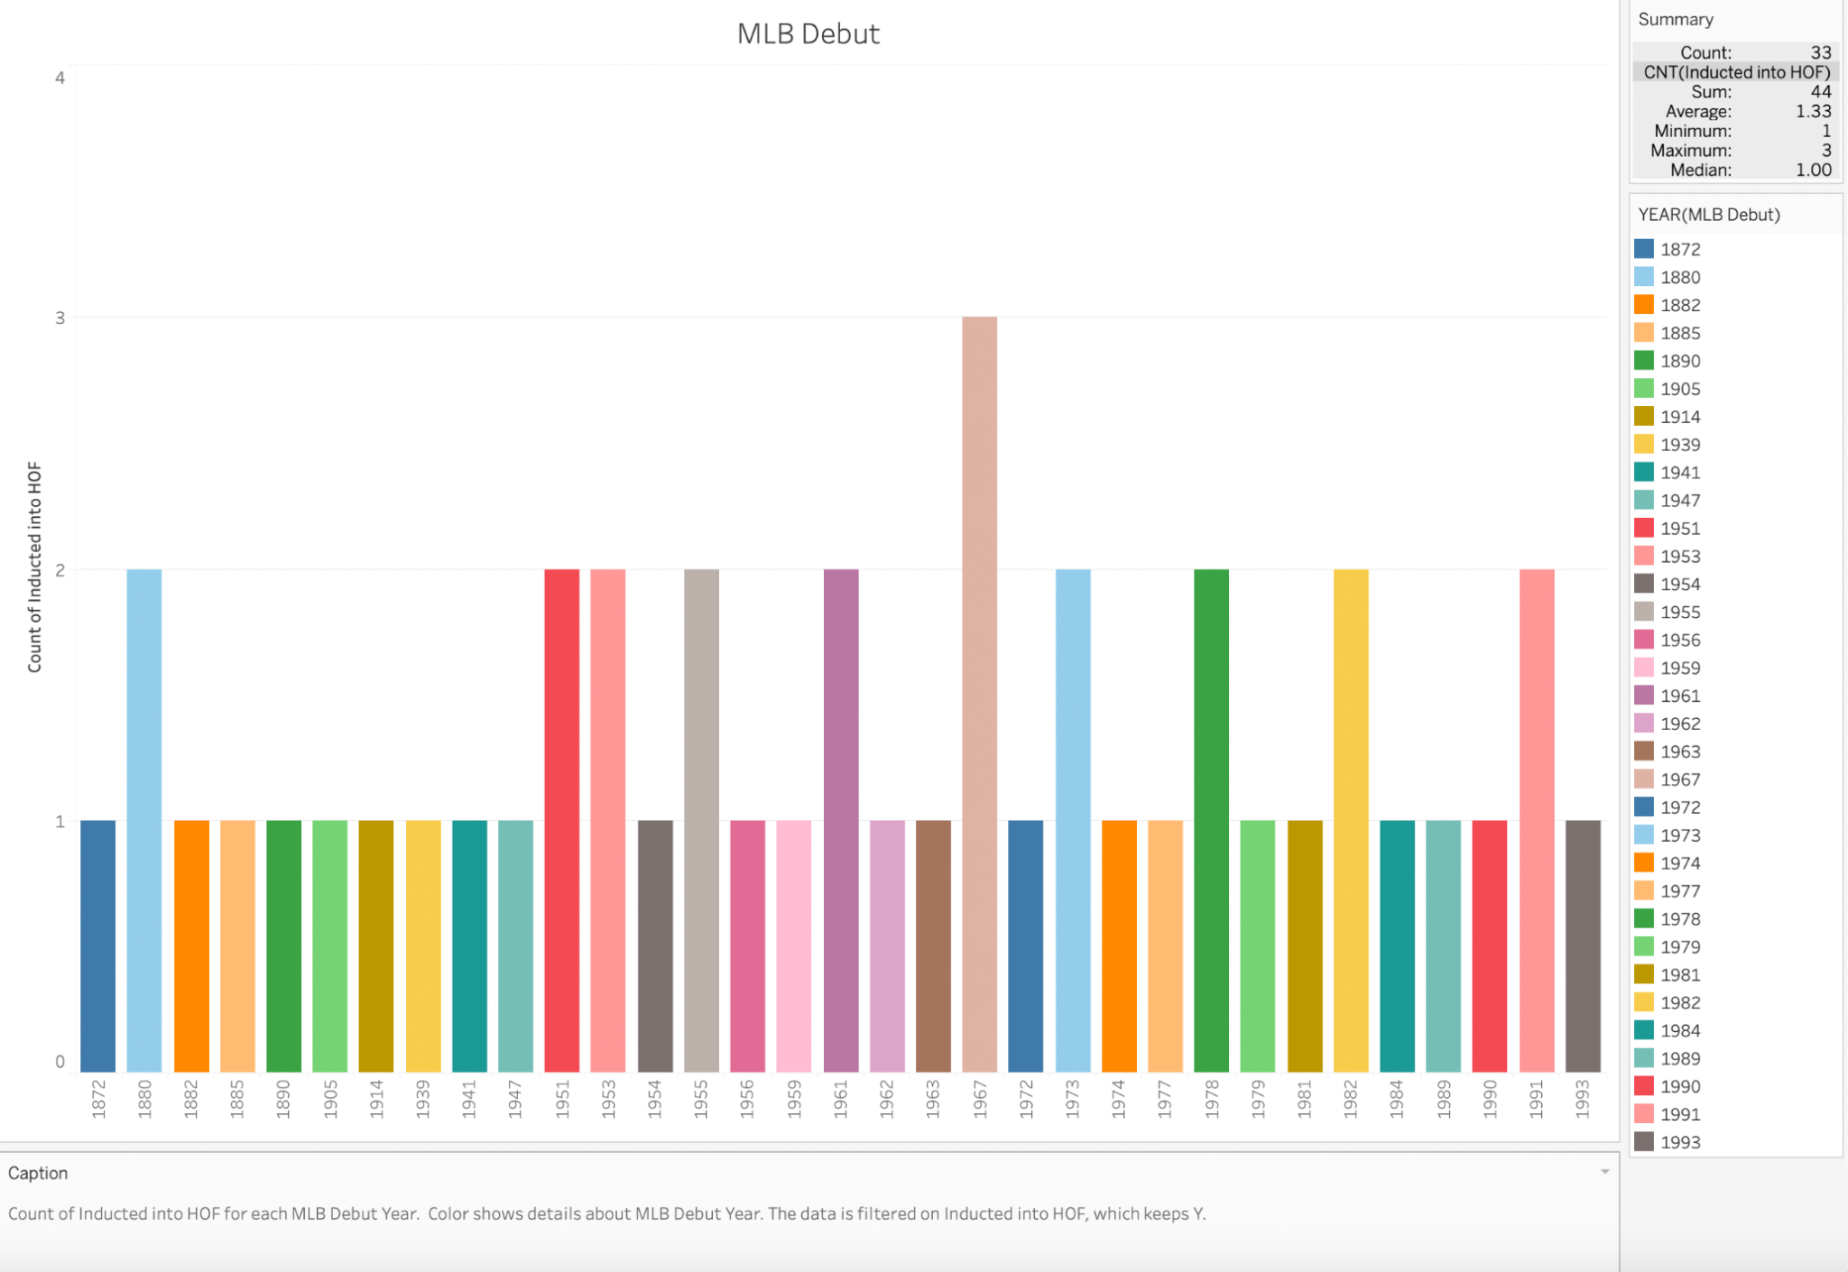

Slide 15
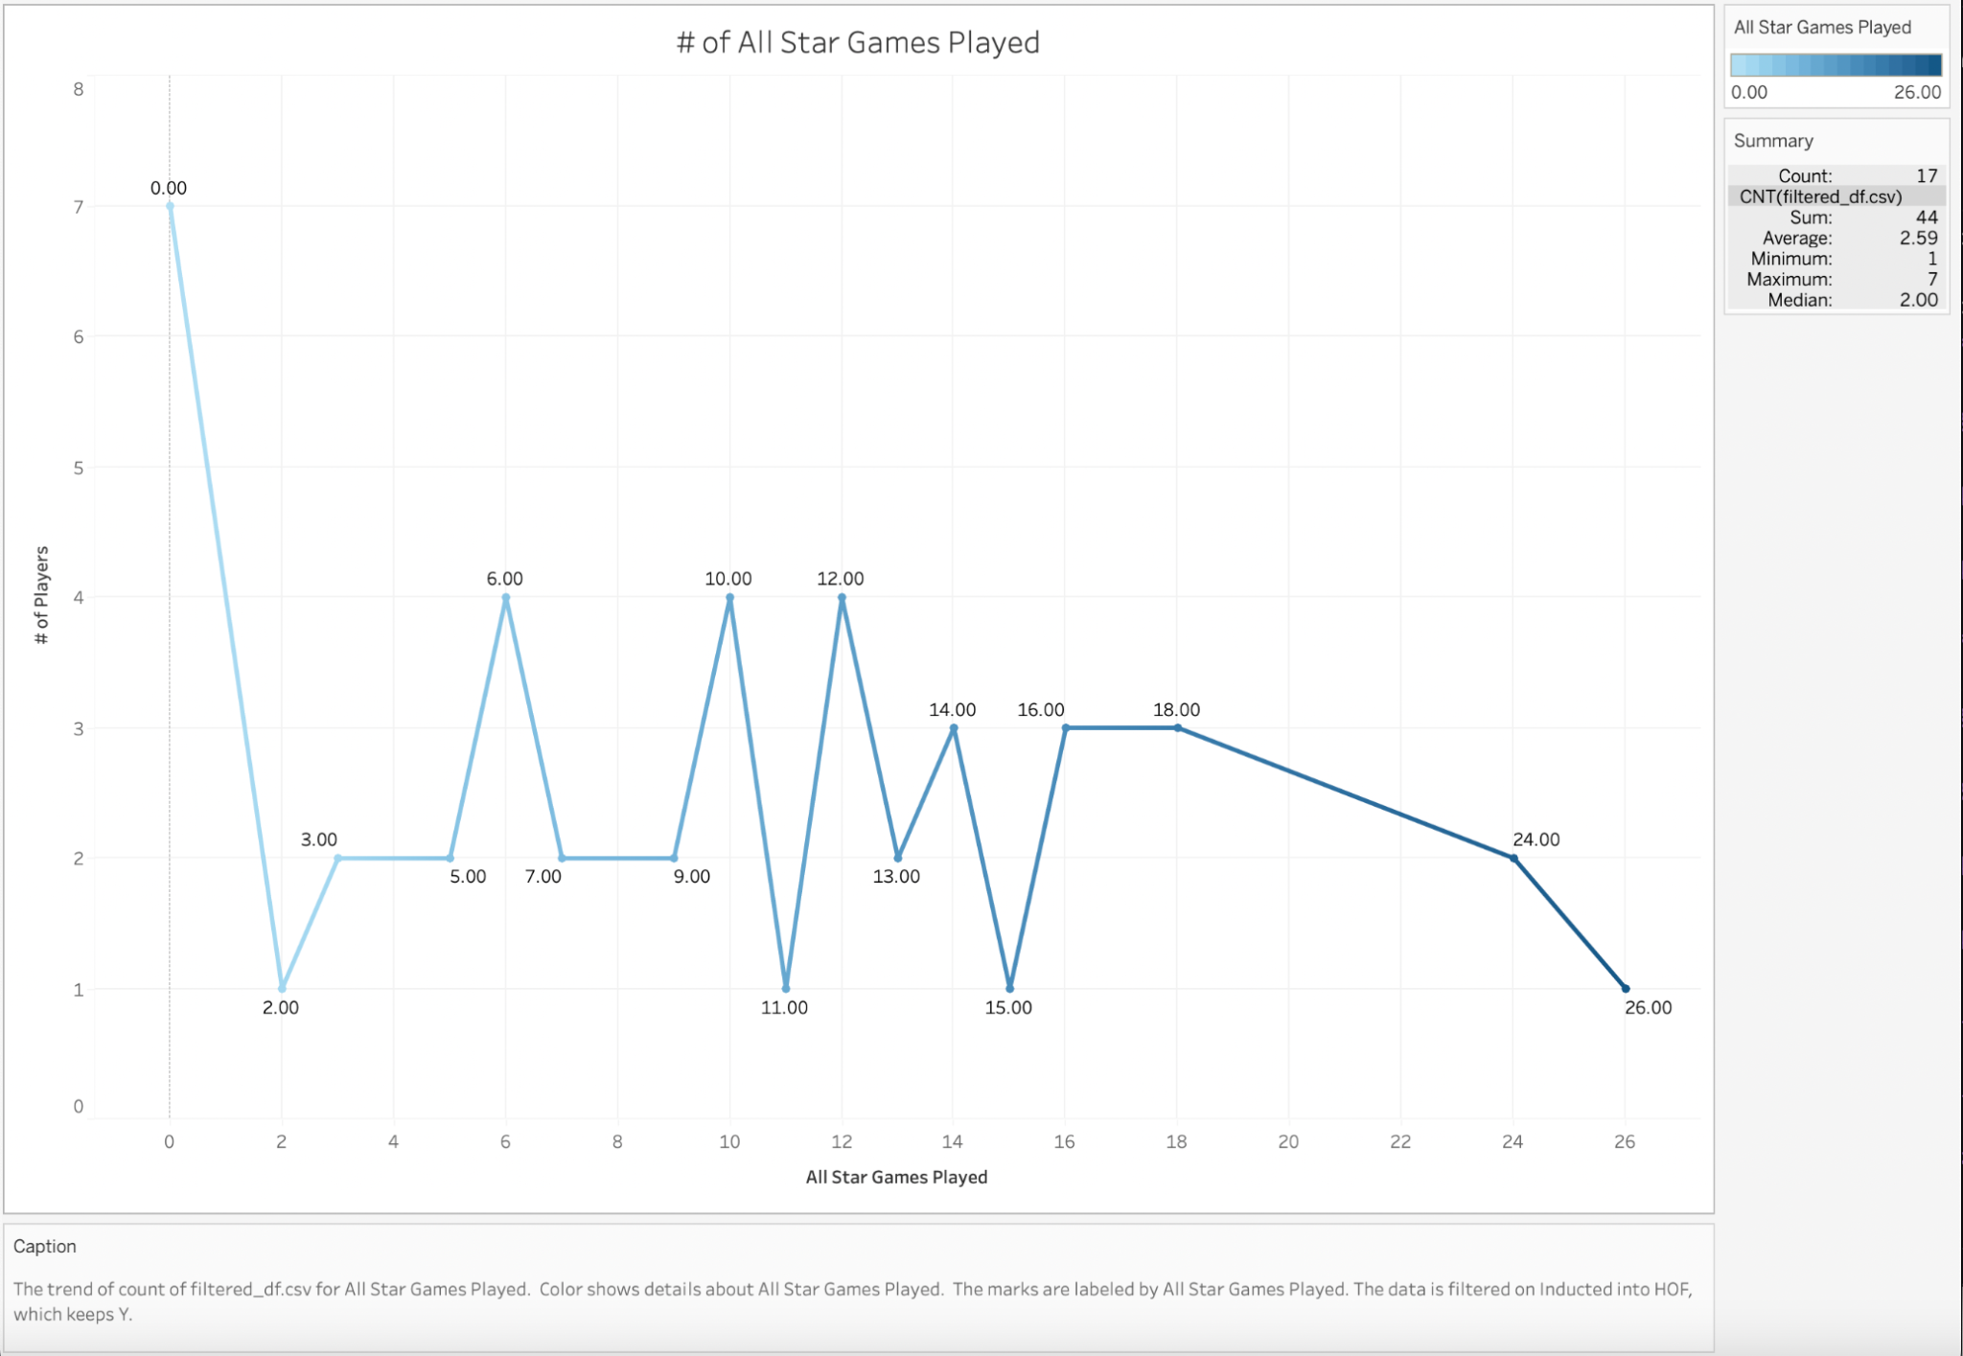

Slide 16
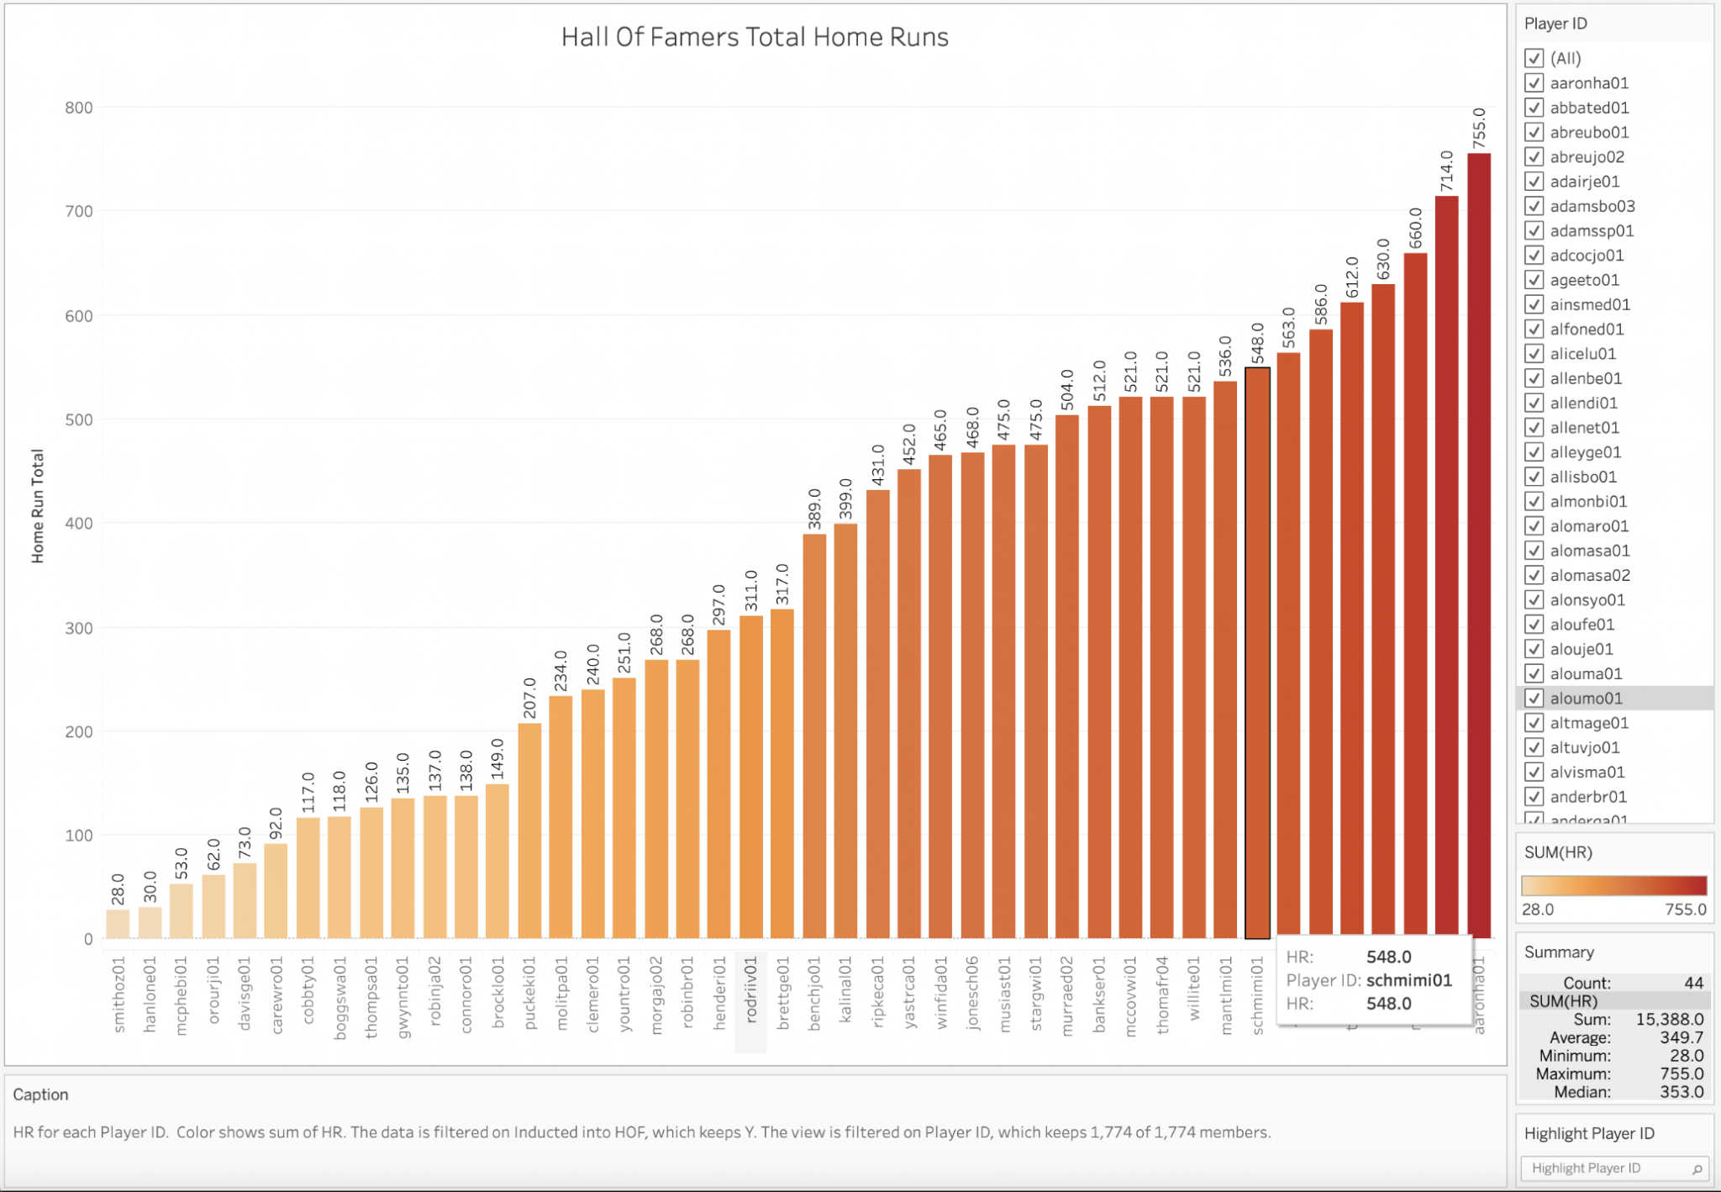

Slide 17
Conclusion
In conclusion, the model that we chose has a high accuracy to predict whether a future Major League Baseball player will be inducted into the Major League Baseball Hall of Fame.
The SMOTEENN model resulted as the best out of all the models we tested based on precision, recall, F1 score, and accuracy score.

